Slide 1
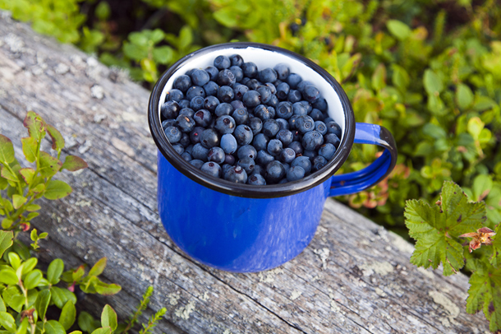
Vaihda kuva painamalla hiiren ”oikeaa korvaa” ja valitse vaihda kuva, jotta kuvan koko ei muutu
OTSIKKO – palvelua hyvin kuvaava otsikko
Tee houkutteleva, markkinoinnillinen teksti, jossa kerrot, miksi tuote on niin ainutlaatuinen, että se on pakko ostaa. Tee teksti englanniksi.
Duration: palvelun kesto tunneissa & vuorokausissa
Location: Missä tuote on saatavilla
Group size: minimi ja maskimi, esim. 1-20 pax
Availibility: milloin tuote on saatavilla, esim. all year round tai June-August
Price 20xx: Alkaen hinta ja brutto vai netto
Starting from EUR xx / person. Families (2+2) EUR xx / fam (brutto)
What’s included: mitä palveluun sisältyy? Esim. guidance, fireplace usage
Supplements: mitä lisäpalveluita on saatavilla? Esim. snacks, coffee by open fire
Booking and information: Yritys, yhteyshenkilö, puhelinnumero, sähköposti, verkkosivu
Vaihda logo samalla tavalla kuin pääkuva

Slide 2
ALPACA PICNIC
Join us for a Memorable Alpaca Picnic Experience.
Discover the charm of our local alpacas in the beautiful seasons of spring, summer, and autumn.
During the experience, you gain fascinating insights into the world of alpacas with a short informational session and embrace the unique opportunity to freely socialize and interact with our furry friends. A delectable picnic box filled with sweet and savory delicacies, lovingly prepared by Café Mathildedal, offers you a unique experience like no other.
Gather your loved ones for an unforgettable moment of outdoor adventure with our delightful alpacas. Bring together your own group of up to 8 people and embark on this enchanting picnic adventure. It's the perfect outing for family, friends, and nature enthusiasts alike.
Duration: 1 hour
Location: Mathildedal Ironworks Village, Salo, South-West Finland
Group size: max 8 pax
Availibility: May, June, July, August
Price 2024 (net): EUR 39 / adult, EUR 27 / child (under 3 yo.free of charge)
What’s included: The price includes a picnic box with sweet and savory delicacies and beverages, a short introduction about alpacas and free socializing with alpacas.
Booking and information: Hotel Mathildedal, www.mathildedal.fi | info@mathildedal | tel. +358 50 3542 487

Slide 3
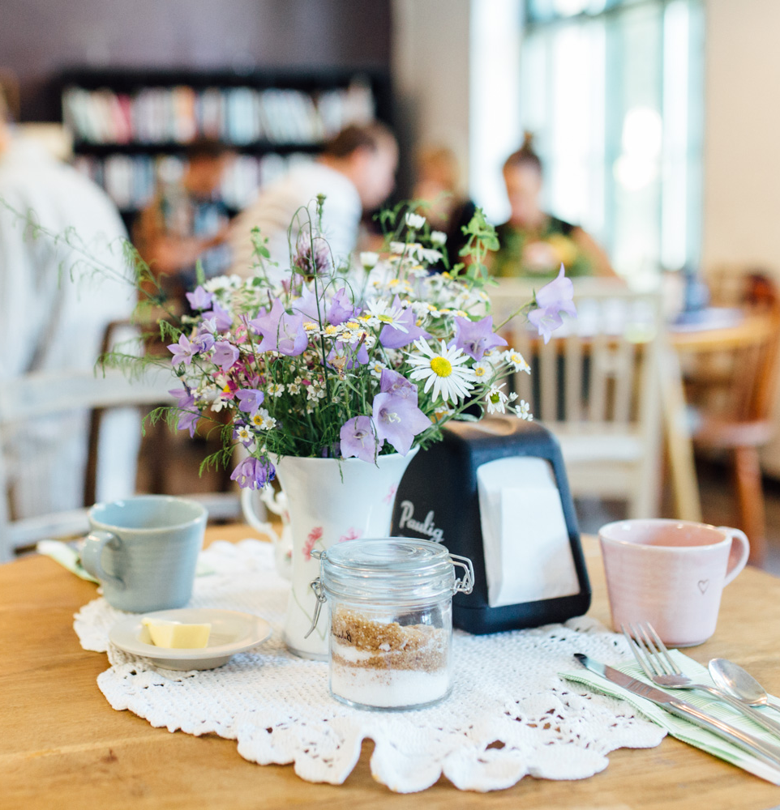
VILLAGE AND WILDLIFE IN MATHILDEDAL IRONWORKS
This package is for you who want to experience the idyllic village lifestyle in Mathildedal Ironworks village and enjoy the Finnish pure nature. Peaceful walks in the forests, beautiful scenery to the archipelago, melodious birdsong, campfire and nature all year round. Allow yourself natural luxury, some time to relax and plenty of enchantive experiences in Southwest Finland.
Day 1. Nature Day In Teijo National Park you can experience the Finnish nature in miniscale; lakes, forests, marshes, streams and sea. It’s also called a pearl of nature tourism. There is about 50 km well-marked trails waiting for you in the forest. Take along a lunch box filled with locally made sausages and snacks. Make a campfire yourself and enjoy lunch next to open fire. After your hike, refresh yourself in the Finnish sauna and try wild swimming in lake Matilda or Baltic Sea.
Day 2. Village Day You will surely enjoy your time off in the old historical ironworks village Mathildedal close to the sea. You will get inspired of a special slow village lifestyle. In Mathildedal ironworks village you can visit an alpaca farm with its mill, local craft brewery and artisan bakery, local cosy pub with its own coffee roastery, small shops, art exhibition, guest harbor, local restaurants and small cafés to choose from.
Duration: 3 days, 2 nights, self-guided day tours
Location: Mathildedal village, Salo, South-West Finland
Group size: 2-14. Larger groups available on request
Availibility: year around
Price 2020 - 2021 (brutto): EUR xxx / person
What’s included: accommodation in shared twin/double room with breakfast, 2 nights, hiking map, campfire kindling and lunch box of locally made products, sauna (1 h). A map for a walk through the historical village, coffee and homemade cake in the local café.
Supplements: Single room, extra night, bicycles, fishing equipment & permit, nature or culture guide, half board
Booking and comissions: Hotel Mathildedal, www.mathildedal.fi | info@mathildedal | tel. +358 50 3542 487

Slide 4
SUPERFOOD FROM THE FOREST IN TEIJO NATIONAL PARK
Finnish natural forest berries are packed with vitamins and nutrients. In Finland there is a tradition of eating berries like blueberries and lingonberries as part of the healthy daily diet.
Everyone has the right to enjoy nature under the traditional Finnish concept of ’Everyman’s Rights’. This means that anyone can walk freely in the fields, forest or countryside and pick berries or mushrooms, another Finnish superfood. Together with these wide-ranging rights comes the responsibility to respect nature, other people and property. There are also special regulations in national parks. Everyman’s Rights means it is not acceptable to disturb people, damage property or litter.
Guided berry-picking tour during the summer months and mushroom-picking tour in autumn takes you to popular spots in Teijo National Park. You will explore the park with nature guide who will tell you about the area and the health effects of nature.
In these guided tours you will see special places in the forest where berries and mushrooms can be picked safely and easily. You can also prepare the mushrooms for a meal by an open campfire.
Duration: 2 – 4 h
Location: Teijo National Park, Salo, South-West Finland
Group size: min 5 pers, max 15 pers
Availibility: For berry picking end July until September. For mushroom picking August – November. Note that it is not quaranteed that plenty of berries and mushrooms will be found.
Price 20xx (brutto): Starting from EUR xx / person. Families (2+2) EUR xx / fam (
What’s included: guidance, fireplace usage
Supplements: snacks, coffee by open fire
Booking and comissions: Yhteyshenkilö, Yritys, puhelinnumero, sähköposti, verkkosivu/verkkokauppa

